Slide 1


‘We are recreating Bedlam’: the crisis in prison mental health services (Guardian,24 May 2014)
‘Mentally Disordered Prisoners: Drawing on History’
Dr Catherine Cox, University College Dublin
and Professor Hilary Marland, University of Warwick

Slide 2

Prisons and Mental Illness: A History
Though the relationship between mental breakdown in prisons has been widely acknowledged in terms of prisons admitting large numbers of mentally ill people and also as institutions likely to produce mental disease, there has been little detailed historical work on this subject.

Slide 3
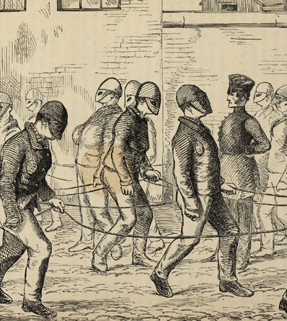
Exploring the possibilities
We will take examples from our historical evidence – from the early decades of the modern prison system (1840s) to the early 20th century.
These are taken from work on our Wellcome Trust Senior Investigator Award: ‘Prisoners, Medical Care and Entitlement to Health in England and Ireland, 1850-2000’ (2014-19)

Slide 4
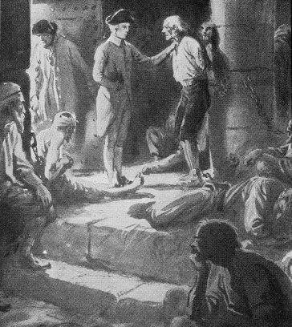
The prison and mental illness: an enduring relationship
‘many of the bridewells are crowded and offensive, because the rooms which were designed for prisoners are occupied by lunatics’.
‘No care is taken of them, although it is probable that by medicines, and proper regimen, some of them might be restored to their senses, and usefulness in life’ (John Howard, 1784).

Slide 5
The prison and mental illness: an enduring relationship
Since the inception of the modern prison system in the mid-nineteenth century to the current day, the relationship between mental illness and the prison has been hotly contested in terms of
why so many prisons came to contain large numbers of mentally ill people AND
the tendency of prisons as institutions to produce or exacerbate mental illness

Slide 6
The prison and enduringly high rates of mental illness
In 2002 it was reported that in England 72% of males and 70% of females sentenced suffered from two or more mental disorders.
In 2013 7.6% of remand prisoners in Ireland had a psychotic illness – ten times the rate in the community
In 1851 psychiatrist Dr Forbes Winslow concluded that almost 1.4% of Pentonville’s prisoners were suffering from mental disorders, compared with a rate of insanity in the general population of around 0.25%. This was likely to be an underestimate.
In 1861, the mortality rate among ‘lunatic’ prisoners in Irish prisons was reported to be 13% - it was under 1% among all other prisoners.

Slide 7
Purpose of the workshop
We seek to link the historical past with the present, to question whether a comparative approach is helpful in highlighting parallels and differences, and examine the ways in which historical research might inform, enhance and shape discussions on prison mental health today.
We are interested in exploring continuities and breaks in issues and practices, recurring and persistent challenges, and pressure points and responses to them.
We also ask how current debates and key issues regarding mental health in the prison system might prompt, shape and inform our historical inquiries and questions.

Slide 8
Can history speak to policy?
History&Policy: ‘is inspired by the belief that history can and should improve public policy making, helping to avoid reinventing the wheel and repeating past mistakes’.
‘Knowledge of the past can provide essential background information’; ‘help those grappling with policy issues understand the context in which previous decisions were made and… evaluate a range of policy options’.
We conceive of it as a two-way collaboration: current complex policy issues may have parallels or antecedents in history that historians should be alert to when pursuing research. While not necessarily dictating historians’ research agendas, such issues can help shape our questions and act as a springboard for our historical inquiries.

Slide 9
1. Prison regimes and mental health
‘Prison appears to be a good greenhouse for developing mental health problems’ Parliamentary Committee on Human Rights (2004).
Dr Francis Rynd, surgeon to Smithfield Depot, Dublin and later medical officer at Mountjoy Prison observed in 1846:
‘It must be remembered that in these small cells men will be located for at least 14 hours out of the 24 from 3 o clock in the day to 7 o clock next morning for four Months in the year that too at a season when the miasma of Fever is most prevalent in this country…. Men who from low Moral principles, confinement, fear of Punishment, Grief at their separation from family & friends, and perhaps from remorse from crimes, have lost vigour and elasticity of life so protective of sound health, and sunk into the torpid depression of mind and body.’
(NAI, Convict Prisons Minute Book 1846–48, GPO 1846/39)

Slide 10
Prison regimes and mental health (ctd.)
Sir Joshua Jebb, Surveyor-General of Prisons, urged in a memo to Wakefeld Convict Department in Jan. 1849, that
‘The question of the amount of Diet to be given to men in separate confinement should not however be regarded merely as one of pounds shillings and pence: - the question is how much is necessary to enable them to bear the discipline without greater depression to their physical and mental powers’.
(TNA HO Papers 45/1448)
In the late 1850s Sir Walter Crofton developed the much lauded ‘mark’ or ‘Irish system’ at Mountjoy Prisons. It modified separate confinement, placing prisoners on public works in association and ‘rewarding’ them for their labour. The system was praised with claims that prolonged ‘use [of separate confinement] can only weaken the offender’s moral and mental stamina’ and for ensuring ‘there are no belly bribes in the Irish system’, a clear criticism of Jebb (Rev. W.L. Clay Our Convict Systems (London, 1862), p. 6; p.41)).
Mountjoy apparently had lower rates of mental illness under the mark system.

Slide 11
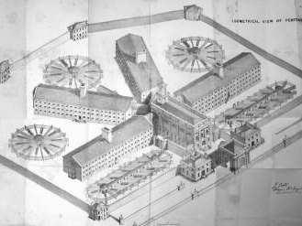
Pentonville, established 1842
Pentonville operated ‘like a machine’ with every minute of the convicts’ day from the first bell at 5.30am until lights out at 9pm, regimented, directed, and observed in meticulous detail, whether at work, exercise or in the chapel (Ignatieff, A Just Measure of Pain, 3-9).

Slide 12
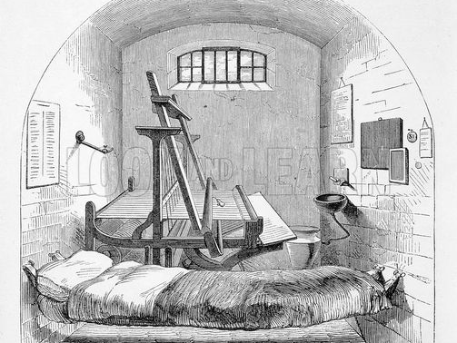
Separate cell Pentonville
Prisoners were not to communicate with each other, but worked, ate and slept in their cells, spending almost 23 hours of each day there. They were moved through the prison with their faces covered by masks, or hoods, seated in chapel in separate closed stalls, while exercise took place in separate airing yards (TNA PCOM 2nd Report, 18-20, Appendix B, No. 3 ‘Routine of a Day’).

Slide 13
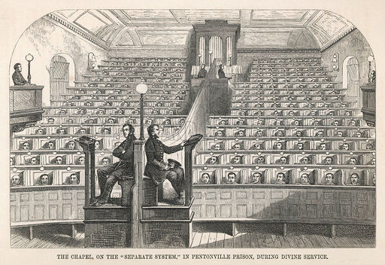
The Pentonville chapel
The prison chaplains were key figures in communicating with prisoners, asserting themselves in matters of the mind.

Slide 14
2. Separate system to solitary confinement
It was the system of separate confinement, implemented in its fullest form in Pentonville Model Prison (1842), that had the most powerful association with mental breakdown.
The system was intended to give extraordinary power over the minds of prisoners in encouraging reform and repentance. Reverend Clay, Chaplain at Preston, described how ‘solitude was a terrible solvent’.
‘a few months in the solitary cell renders a prisoner strangely impressible. The chaplain can then make the brawny navvy cry like a child; he can work on his feelings in almost any way he pleases… and fill his mouth with his own phrases and language’. (Ignatieff, pp.197-9)
Charles Dickens condemned the separate system as ‘cruel and wrong’, ‘this slow and daily tampering with the mysteries of the brain’. (‘American Notes’, The Times, 25 October, 1842).

Slide 15
Separate system to solitary confinement (ctd.)
There are ‘few places more calculated to defeat this end than Mountjoy Prison, where its gloomy appearance, peculiar construction and surrounded as it is by high walls, cannot fail to exercise a depressing influence on the minds of such a class’
(Dr Young, Mountjoy, MO, GPO Corr Box 64 1872/18).
In 1857/58 Governor Anderson at Liverpool Borough Gaol observed that
‘in the number of persons who are from time to time committed to this prison, there are some who are predisposed to insanity, or whose minds are weak, or who are subject to delusions or other mental affections, and it is very probable that separate confinement may have a tendency to cause such maladies to be more fully developed’. (Twenty-second report of the inspectors, [1857-58]).
When Michael Cody, RC Chaplain, Mountjoy insisted in his 1869 Annual Report ‘that to subject the prisoners to the separate discipline for eight months is calculated to injuriously affect them mentally as well as physically’, the Director of the Convict Prisons annotated his report with the rebuke that ‘the Directors do not concur with these opinions ….’ (16th Annual Report, Directors of Convict Prisons for Ireland).

Slide 16
3. Separate system to solitary confinement: risk of suicide
In 1856, one year after the opening of Liverpool Gaol, prison inspector Herbert P. Voules reported that ‘six … prisoners’ had ‘feigned attempts to hang themselves, with a view to procure their removal from separate confinement’. These were in addition to three other attempts, one of which was ‘successful’ while two other prisoners were transferred to lunatic asylums.
(Twenty-second report of the inspectors, [1857-58]).
In June 2015 the Independent reported
The number of prisoners who take their own lives in solitary confinement reached a nine-year high;
Jails were urged to scale back the use of ‘18th-century’ punishments against offenders perceived as being disruptive or in danger from other inmates.

Slide 17
4. Hearing the prisoners’ voice
Susan Fletcher, confined in Westminster Prison for 12 months in 1884, described how ‘Each prisoner is locked in her solitary cell for twenty-three hours out of every twenty-four; which is in itself a very dreadful punishment bad for the health of the body, worse for the health of the mind – abnormal, inhuman, diseasing, demoralizing’.
Florence Maybrick, incarcerated in Woking Prison, declared that
‘No one can realize the horror of solitary confinement, who has not experienced it’.
‘It inflicts upon the prisoner at the commencement of her sentence, when most sensitive to the horrors which prison punishment entails, the voiceless solitude, the hopeless monotony, the long vista of tomorrow, tomorrow, tomorrow stretching before her, all filled with desolation and despair. Once a prisoner has crossed the threshold of a convict prison, not only is she dead to the world, but she is expected in word and deed to lose or forget every vestige of her personality…’
Susan Willis Fletcher, Twelve Months in an English Prison (1884), 328; Florence Elizabeth Maybrick, Mrs. Maybrick’s Own Story. My Fifteen Lost Years (1905), 68, 74.

Slide 18
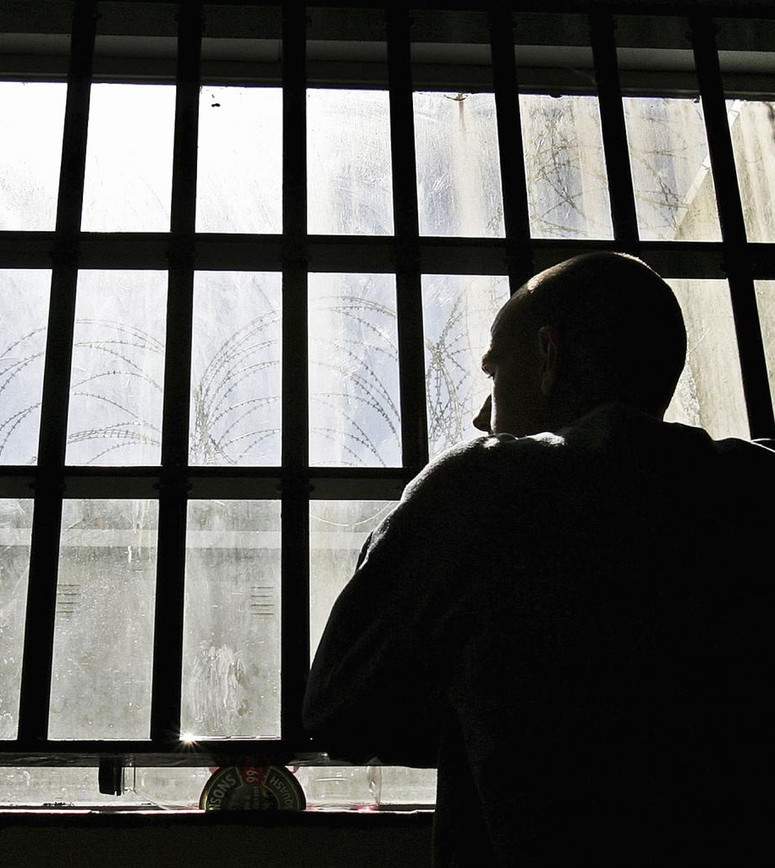
Hearing the prisoners’ voice (ctd.)
‘It’s long. It feels like the day is dragging. There’s books, newspapers, but that’s about it.’
‘The longer you’re here, the more you develop disorders. Being in such a small space has such an effect in decreasing your social skills. It looks rosy, but it has such a negative effect. It’s isolation to an extreme.’
Dr Sharon Shalev and Kimmett Edgar, Deep Custody: Segregation Units and Close Supervision Centres in England and Wales (2015), 54-5.

Slide 19
5. Relationship of prisons with mental health services
Both prisons and asylums faced huge pressure in terms of admissions – Liverpool had the second largest and constantly overcrowded asylum system in the country and a prison population which soared to 20,000 by the 1890s, with many repeat offenders and short-term sentences.
Conversely, in Dublin by the 1870s the prison population was declining – the daily average number of convicts in Mountjoy Male Prison was 149 in a building intended for 500 while Richmond lunatic asylum was severely overcrowded.
Historical reluctance to move prisoners to asylums as it represented failure of prison regime, but also due to pressure on mental health care facilities and a lack of options. (Penrose hypothesis)

Slide 20
History… potential contributions
History can highlight areas of concern, continuity and change, and recurring challenges.
It provides good cases studies for stakeholders wishing to identify past obstacles to change and assist in avoiding them.
It highlights different methodologies of reporting and analysis, driven by varied ‘agendas’ in different periods.
Comparative history can also reveal different experiences and solutions to problems and allow for the testing of hypotheses relating to mental health in prisons in varied contexts – as well as the way different systems informed each other.

Slide 21
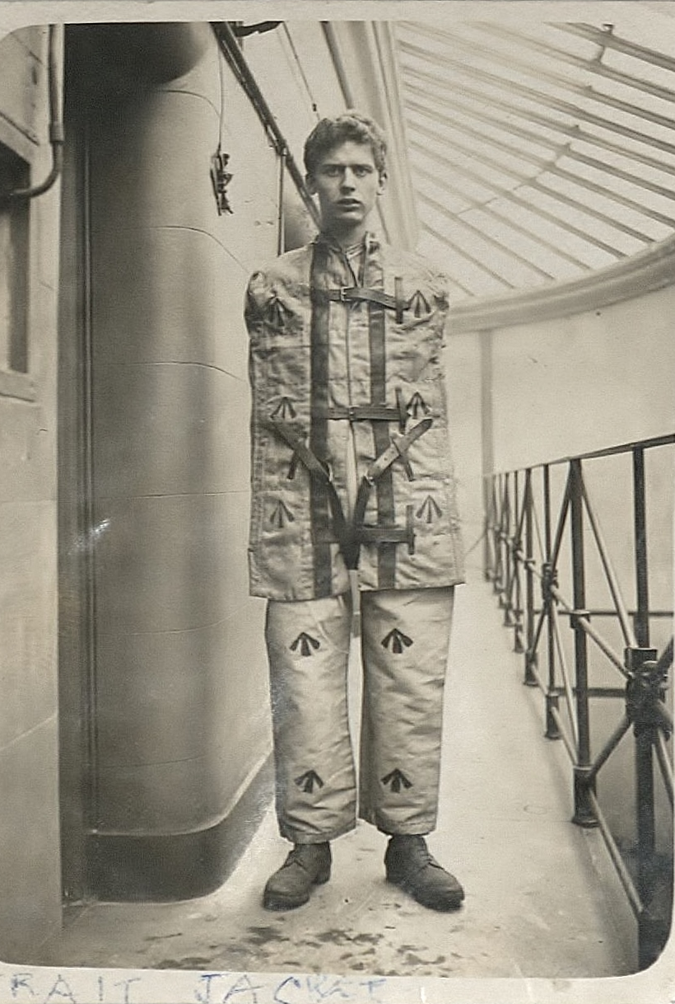
‘The Strait Jacket’, Warwick University, Howard League, Modern Record Centre, MSS/16A/7/23
Thank you for your attention

